Slide 1


CSE 222 data Structures Term Project Warehouse Automatıon
AHMET DÖNMEZ 141024008
BURAK ÇİÇEK 1901042260
FURKAN ÇELEN 1801042628
HATİCE ARGUN 141044082
MEHDİ KURTCEBE 1801042667
MEHMET HÜSEYİN YILDIZ 200104004095
SENA ERDOĞAN 1901042680

Slide 2
Problem Definition
This warehouse automation application provides good features for companies that needs fast and simple UI for their product supplying. There are many supermarket chains that keep track of their stocks manually and this causes conflicts between the warehouse and branches. Some of these problems are inconsistencies in registration of the products, products being delivered later than expected, quantities of the products in the branches not matching the warehouse’s stock, since the stock is not trackable, products cannot be delivered to the branches at the predicted time.
It is aimed to eliminate these problems for companies with the automation system we will prepare.

Slide 3
Users of the System
Warehouse Administrator > can add and remove employees, branches, and products.
Warehouse employee > can see product requests from branches and accept or reject them, send products to branches, inform administrator for out of stocks in the warehouse.
Branch employee > can make sales and request product from the warehouse.
Transportation employee > can update shipment status.

Slide 4
Non-functional Requirements
Utility
The system shall be user friendly.
The system shall be constructed by a trained administrator firstly then can be used by non-expert personal.
The system UI must be not complex for users.
Reliability
The system should give error messages against the illogical process attempts.
The system should provide error handling mechanisms to prevent system crashes.
Performance
The system would have very little amount of data at the beginning, but as the users use the system, the amount of data in the system increases and here, the system needs to increase efficiency by using fast algorithms on top of these data. The system targets this in terms of efficiency.

Slide 5
Non-functional Requirements
Space requirements
The system will store old users' data on the server side. These are the login information of the users, products, requests that were created by the users. Since, all these data tend to be enlarged as the new users register the system, and the users make use of the system. Therefore, the system should be scalable.
Supportability
The system should be portable, so moving from one OS to another OS shall not create any problem.
User Interface
All the user operations will be done through any standard PC and user will not need another hardware.
Domain Requirements
The system server shall work on Windows, Linux –Ubuntu and Mac Os.

Slide 6
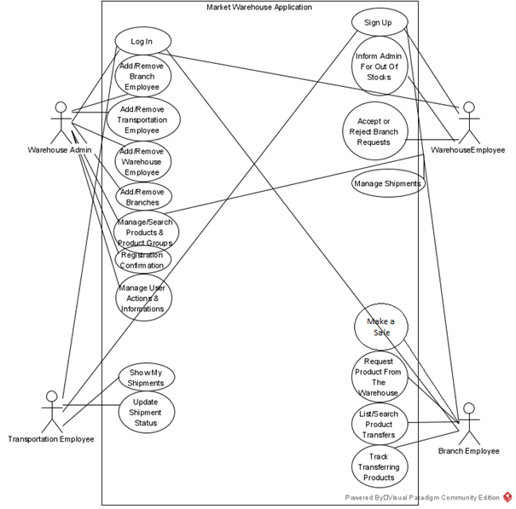
Use Case Diagram

Slide 7
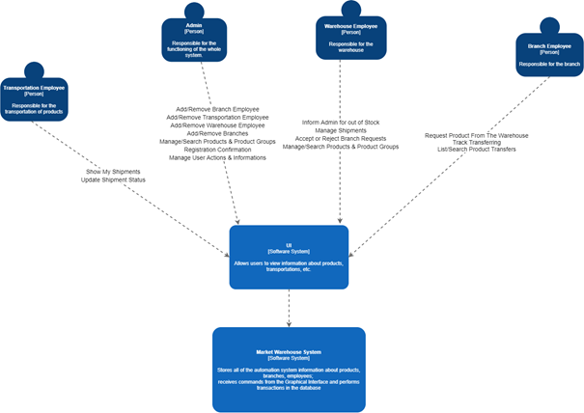
Context Diagram

Slide 8
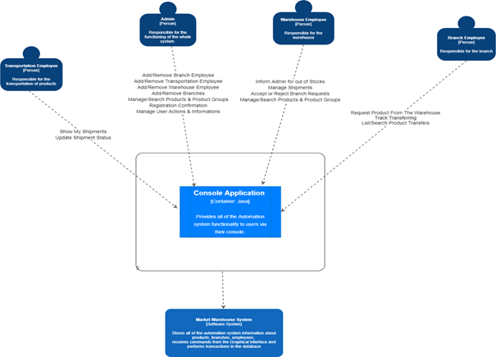
Container Diagram - 1

Slide 9
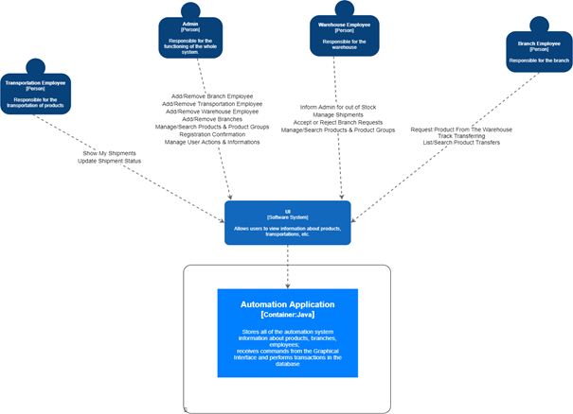
Container Diagram - 2

Slide 10
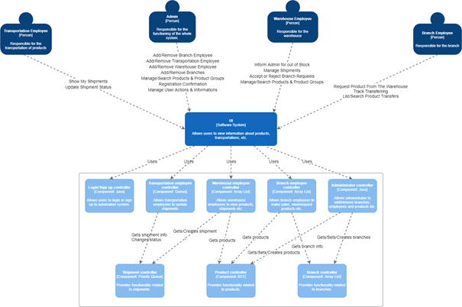
Component Diagram

Slide 11
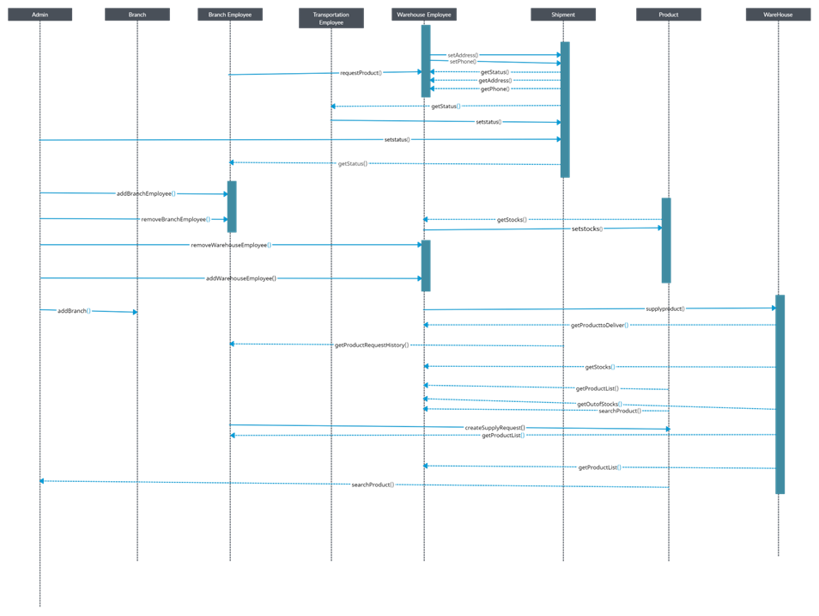
Sequence Diagram

Slide 12
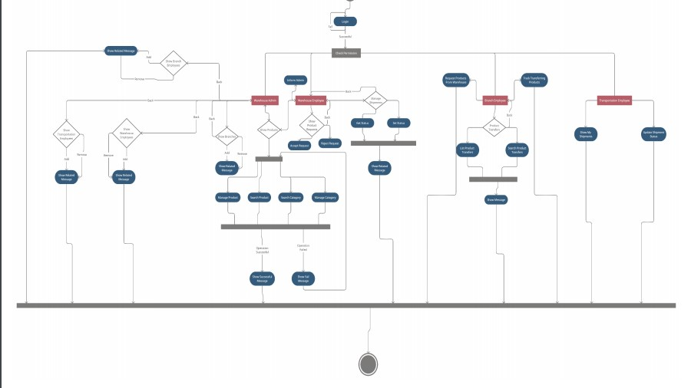
Activity Diagram

Slide 13
Data Structures Used for Components
To assign shipments to transportation employees automatically and fairly, we decided to store transportation employees in queue data structure. We predicted that users would make many searches on products, so we decided to store products in binary search tree data structure to make searches fast.
Some shipments may be urgent. They may need to be delivered immediately. To provide this, we decided to store shipments in priority queue data structure. Other employees, and branches are stored in array list data structure to get them fast and store efficiently.

Slide 14
Thanks for Listening

